Slide 1
Le Chéile Trust
Building Approval Process
Notes:
Hello. This short presentation sets out the process for obtaining patron approval for building works at your school. Before we begin it may be useful to focus briefly on the role and responsibilities of the BOM, and those of Le Chéile/Síol in respect of Property and building matters.

Slide 2
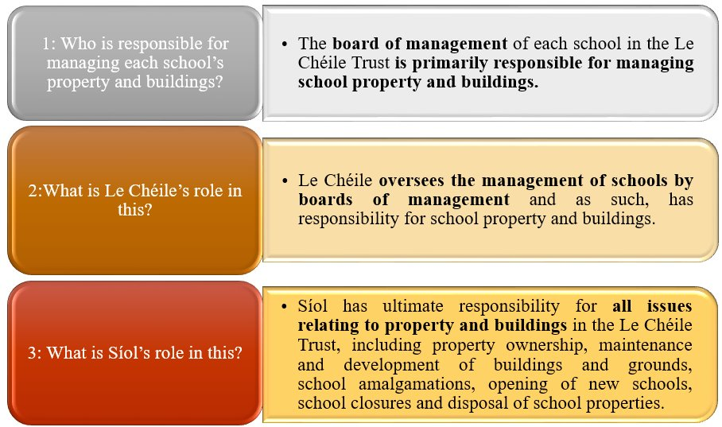
Management of school property and buildings is therefore a shared responsibility between Síol and Le Chéile together with the boards of management of each individual school​
Notes:
The BOM should have awareness and oversight of all building works in the school. However as you can see from this slide, Síol has ultimate responsibility for all issues relating to property and buildings. Síol has now developed and approved Patron approval procedures in order to assist Boards of Management and Principals in ensuring that all required patron approvals are obtained and recorded.

Slide 3
This Approval Application process must be followed by all Le Chéile Schools proposing to carry out any building works regardless of how the works are being funded (including Emergency Works, Summer Works, Reconfiguration Works for Special Needs class provision, Additional Accommodation, Major projects or upgrade / development of sports facilities).
The only works which may be carried out without approval from the Le Chéile Trust are routine maintenance works which are funded by the school unless those works involve any element of structural work in which case this process must be followed.
BOM are responsible for all aspects of the project including where costs exceed the funding approved by the DoE.
The Le Chéile Trust (through Síol Schools Trust CLG and Le Chéile Schools Trust CLG) has ultimate responsibility for school property and any liabilities incurred. It is essential therefore that the Le Chéile Trust has oversight of all works being carried out on school property at all times.
Notes:
While the majority of building works will be undertaken and funded via one or other of the DE Schemes listed, these preocedures also apply to non DE funded works. Routine maintenance work is excluded unless. It must be constantly borne in mind that the BOM and ultimately the Trust are responsible where costs exceed the approved DE funding. Therefore oversight by the Trust of all works being carried out on school property is essential.

Slide 4
Notes:
Routine building maintenance is a matter for the BOM, however apart from this Le Chéile/Síol need to have awareness of and give approval for all other building works.

Slide 5
Summary of the Le Chéile Approval Process
Notes:
The Approvals process has been developed to align closely with the Department of Education procedures and a key consideration was to minimise any additional workload on Principals. There are four occasions where Patron approval must be obtained. These are referred to as “Gateways” to prevent confusion with DE “Stages”
Gateway 1 – Permission must be obtained prior to applying to the DE for a grant under any of their schemes, or undertaking non DE funded building works.
2. Gateway 2 – Patron approval must again be obtained prior to commencing design of the project
3. Gateway 3 – Again prior to going to tender for the works
Gateway 4 – Approval must be obtained prior to appointing a Contractor
While in practice it is likely to be the Principal who communicates with Síol in relation to this it should be noted that in each case it is the responsibility of the Board of Management to ensure these procedures are followed.

Slide 6
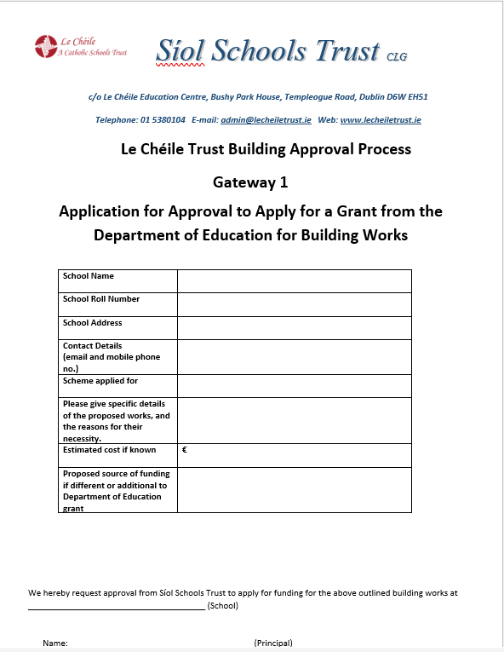
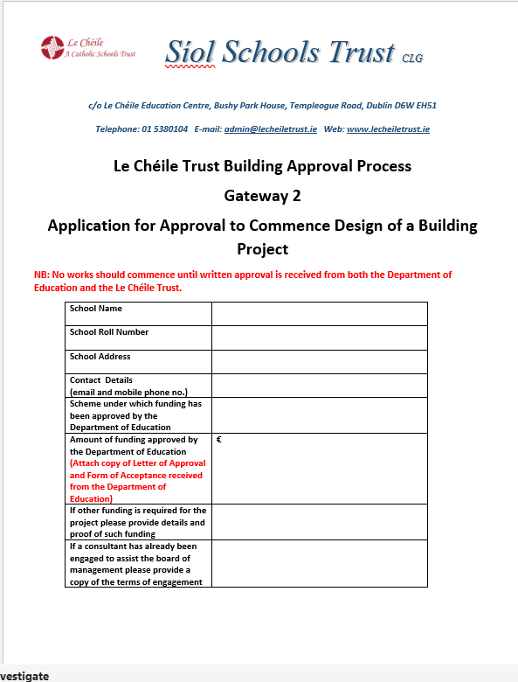
Notes:
There is a separate application form for each Gateway and the correct application form for each Gateway should be completed and emailed to Pat Flynn using the email address pat@lecheiletrust.ie. These application forms will be emailed to all schools shortly and are editable. They specify the required information to enable Síol to make a timely decision on your application. If all of the required information is not included this will result in delays or failure to obtain approval.

Slide 7
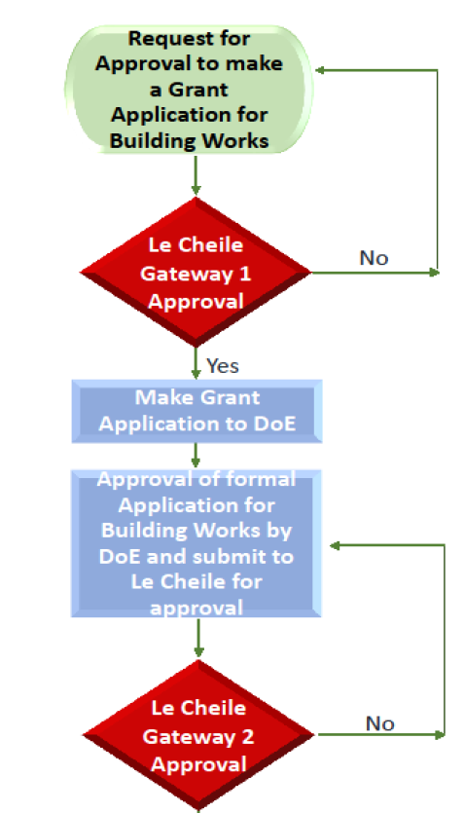
Notes:
Under no circumstances should you proceed with a project unless each required approval has been obtained. This is essential to protect Principal`s, Boards of Management and the Trust. These procedures are being put in place to give boards of management an extra layer of protection to ensure the consultant/ design team engaged is complying with Department of Education procedures and standards.
The flow chart on screen is a visual representation of the process

Slide 8
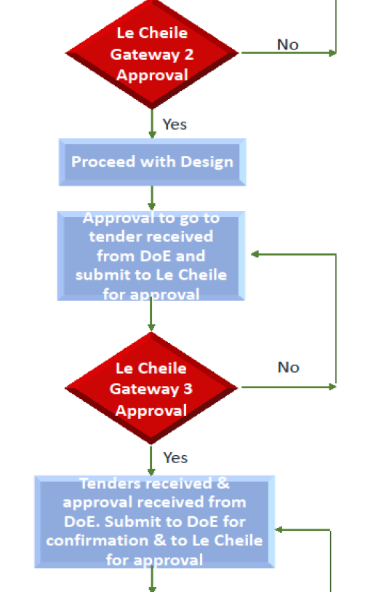

Slide 9
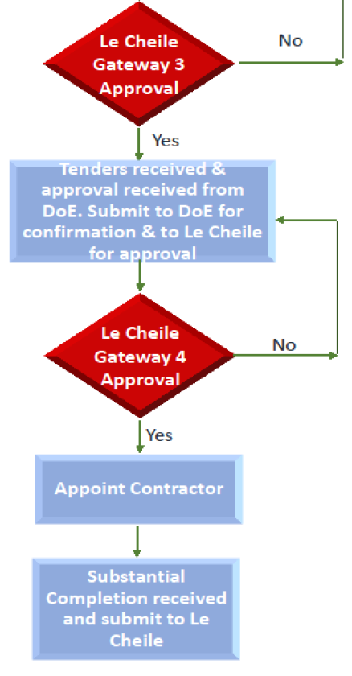

Slide 10
Thank you for your attention.
If you have any queries in relation to the approvals process, please contact Pat Flynn on
pat@lecheiletrust.ie
or
0868256329
Notes:
We hope that this presentation provides some clarity around the approvals process for building works. A copy of the LC Property Policy and a detailed document on these procedures will be emailed to each school Principal and BOM Chairperson following these cluster meetings. Once you have received them and had an opportunity to go through them we will be happy to address any questions or concerns you may have.
Thank you very much for your attention.

