Slide 1
Reflection of Hope & Peace

Slide 2
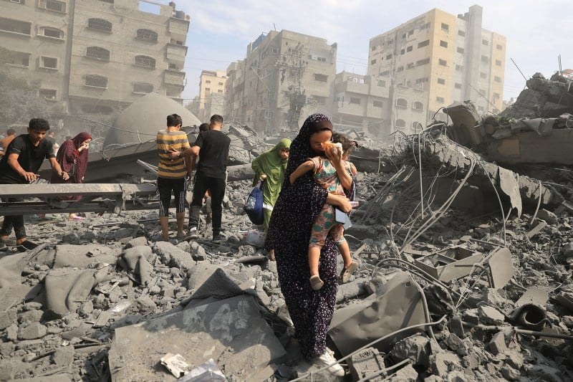
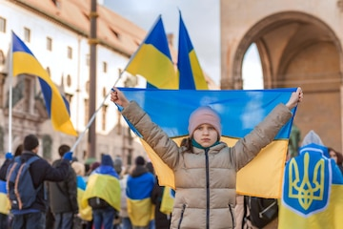
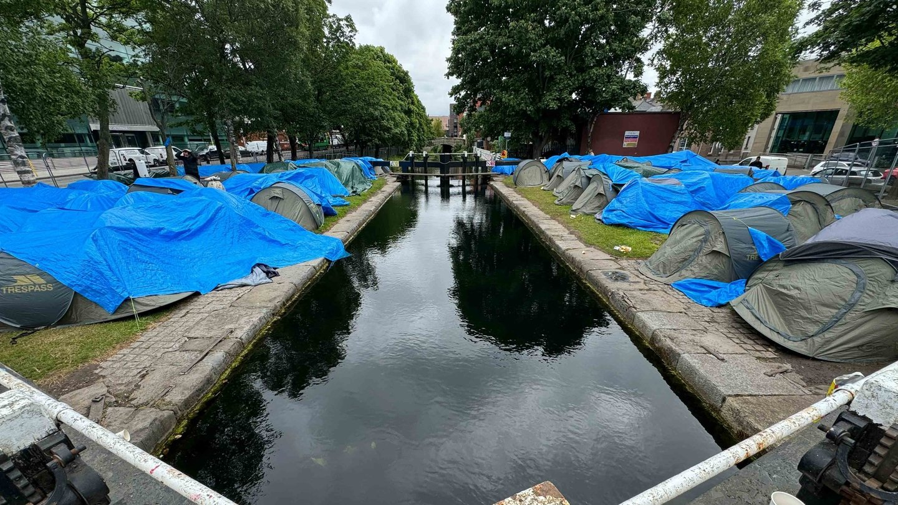
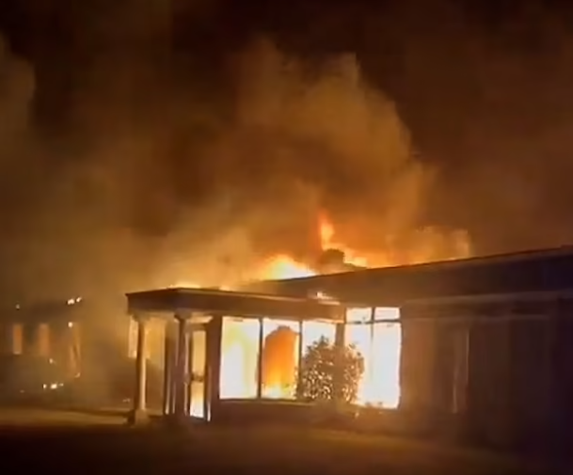
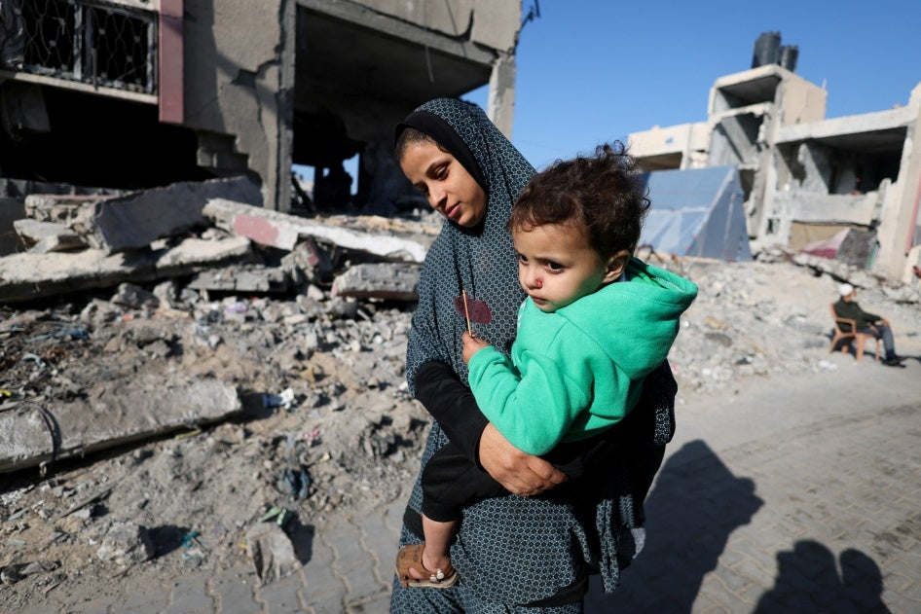
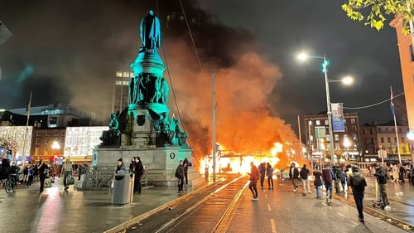
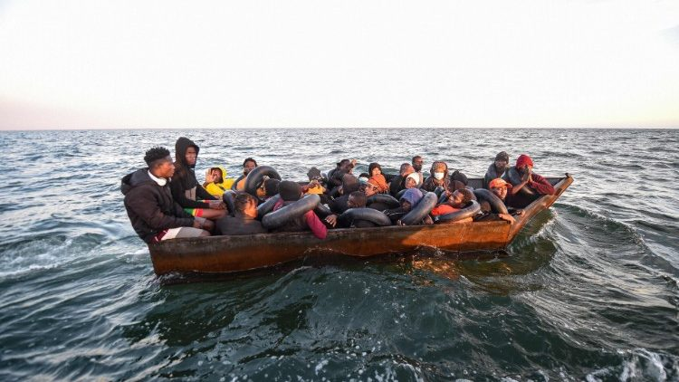
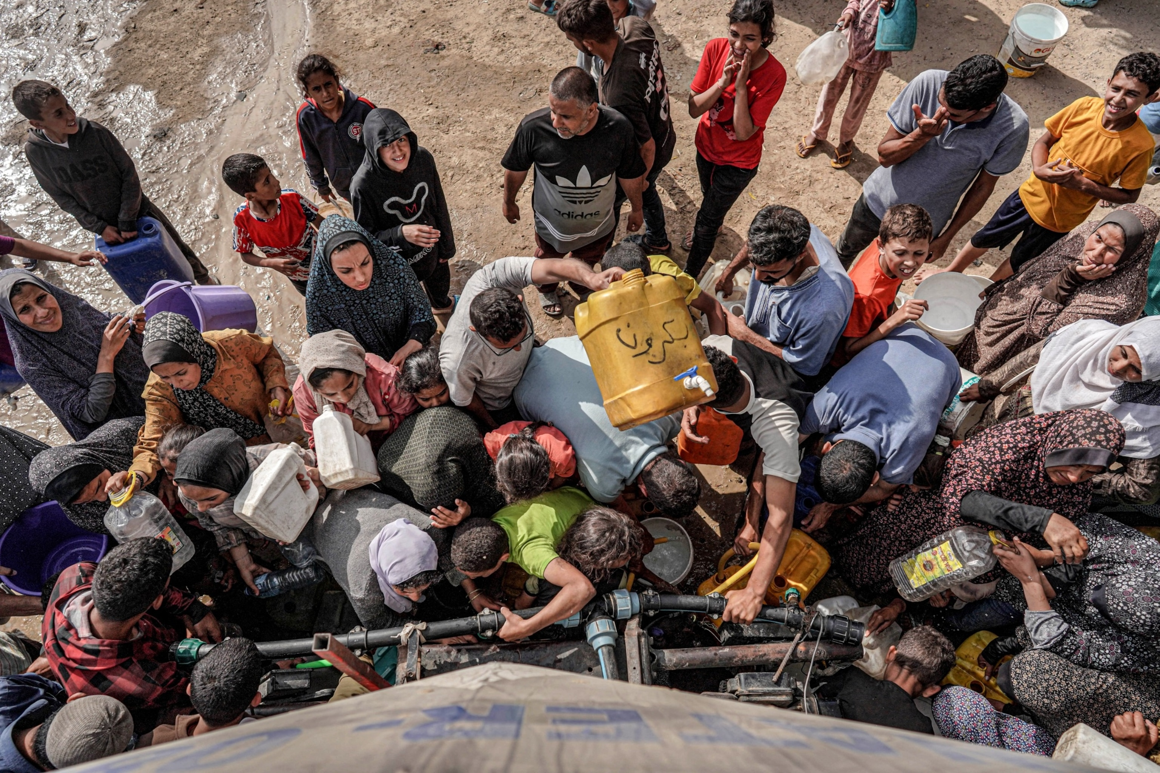
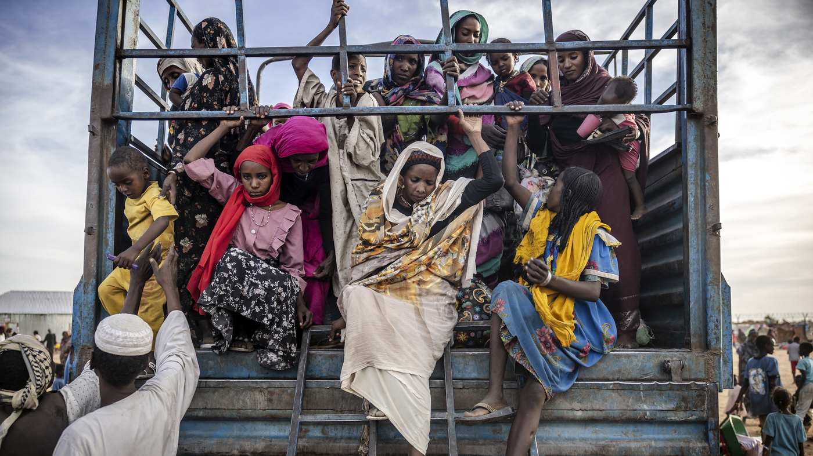

Slide 3
Message of Hope
There is something in the human Spirit that will survive and prevail …..a tiny and brilliant light burning in the heart of every person that will not go out no matter how dark the world becomes.
Leo Tolstoy ( Russian Writer and Pacifist.)

Slide 4
Peace of Mind
I leave my burden in the hands of God, and I go free

