Slide 1
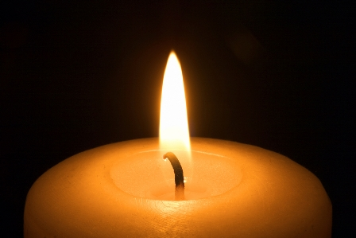
You are invited to….
Relax
Listen
Reflect
Pray

Slide 3
Yesterday’sGospel, the fig tree story
The seed of God is in us.
Now, the seed of a pear tree grows into a pear tree;
The seed of a hazel tree grows into a hazel tree;
A seed of God grows into God (Meister Eckhart)
How can I nurture the seeds of God, the seeds of love, this Lent?

Slide 4
An older Cherokee man is teaching his grandson about life. “A fight is going on inside me,” he says to the boy. “It is a terrible fight and it is between two wolves. One is evil. He is angry, greedy, selfish, arrogant, full of self-pity, guilt, resentment, inferiority and false pride.
The other is good. He is love, peace, joy, hope, serenity, humility, kindness, benevolence, truth, compassion and faith.
The same fight is going on inside you and every other person. The grandson thinks about it for a minute and then asks, “Which wolf will win?”
The old Cherokee replies, “The one you feed.”

Slide 5
Lenten poem by Ann Weems
Lent is a time to take time, to let the power
of our faith story take hold of us,
a time to let the events get up
and walk around in us,
a time to intensify our living unto Christ,
a time to hover over the thoughts in our hearts,
a time to place our feet in the streets of
Jerusalem or to walk along the sea and
listen to his Word,
a time to touch his robe
and feel the healing surge through us,
a time to ponder and a time to wonder…

Slide 6
Lent is a time to allow
a fresh new taste of God!
Perhaps we’re afraid to have time to think,
for thoughts come unbidden.
Perhaps we’re afraid to face our future
knowing our past.
Give us courage, O God,
to hear your Word
and to read our living into it.
Give us the trust to know we’re forgiven
and give us the faith
to take up our lives and walk.

Slide 7
Lord, teach us to pray
God, source of all our activity, we offer our prayer to you as we pray:
Our Father who art in heaven
When we see each other’s gifts, generosity and potential, Lord, teach us to pray:
Hallowed be thy name
When we think that things are impossible to do or to change, Lord, teach us to pray:
Thy kingdom come
When we evade life’s challenges and demands as too idealistic, Lord, teach us to pray:
Thy will be done on earth as it is in heaven
As we try to live and spread the gospel message of love, peace and joy, we need to be strengthened and nourished by your grace and love. Lord, teach us to pray:
Give us this day our daily bread
When we fail in our relationships, and do not have the courage to live in peace and love, Lord, teach us to pray:
Forgive us our trespasses as we forgive those who trespass against us
When we are faced with pressures that are likely to be too much for us, Lord, teach us to pray:
Lead us not into temptation but deliver us from evil
That we may realise that it is your work that we do in building the Kingdom of God, Lord, teach us to pray:
Yours is the kingdom, the power and the glory, now and forever. Amen

Slide 8
A prayer for Ukraine
God of peace and justice
we pray for the people of Ukraine today.
We pray for peace and the laying down of weapons.
We pray for all those who fear for tomorrow,
that your Spirit of comfort would draw near to them.
We pray for those with power over war and peace,
for wisdom, discernment and compassion
to guide their decisions.
Above all, we pray for all your precious children,
at risk and in fear, that you would hold and protect them.
We pray in the name of Jesus, the Prince of Peace.
Amen.
(Archbishop Justin Welby/Archbishop Stephen Cottrall)

