Slide 1
“PAY IT FORWARD DAY”
LE CHEILE SCHOOLS – 15th APRIL 2016

Slide 2
Thought for today!

Slide 3
“PAY IT FORWARD DAY”
In 2015 at the annual Le Cheile conference, the students from the various Le Cheile schools used the American film, Pay It Forward, as a catalyst to consider how they could use their influence to bring about a positive change, that would make the world a better place.

Slide 4
In the film , Trevor does a favour for 3 people, asking each of them in return instead of being grateful to him, they had to promise to pay the favour forward, by doing favours for 3 other people.

Slide 5
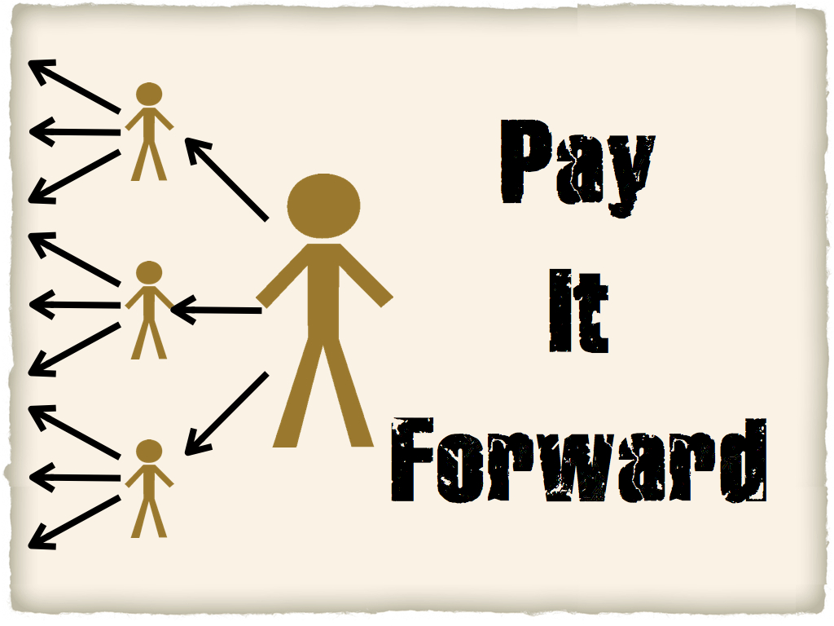
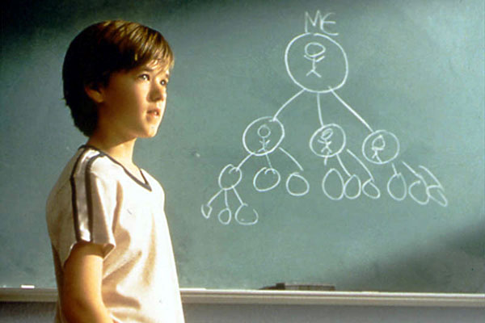

Slide 6
2015
The Pay It Forward day was started in the Le Cheile schools last year.
This year Maryfield College is joining the effort to make the world a better place, starting within our own school.
Help the RE Dept. pay it forward.
Pay It Forward is for the whole School Community.
It is an expression of the caring schools we strive to create.
Our focus this year is on being KIND – and to make someone smile.

Slide 7
Watch this!

Slide 8
RAK – Random Acts of Kindness
Give up your seat on the bus
Hold the door open for someone
Let someone go ahead of you
Help someone with homework
Be friendly to some one you would normally ignore
Share your lunch
Give a gift
Do a job
Clean up rubbish
Donate to charity
Clear out your wardrobe and give it away
Give a treat to someone
Send an encouraging text
Give a compliment

Slide 9
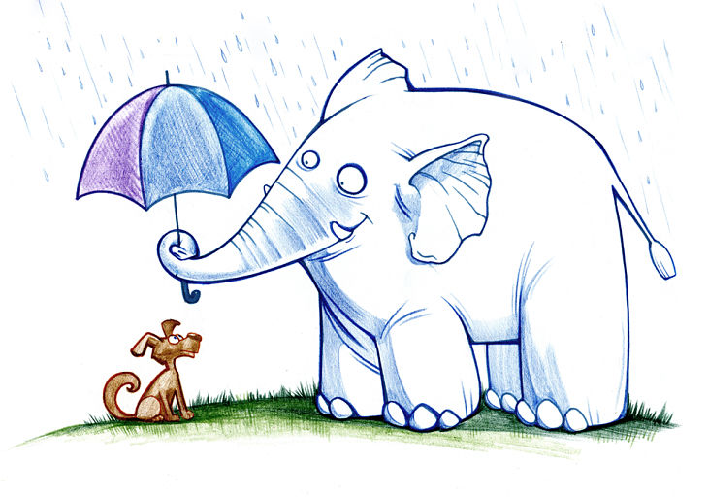
Give a book to someone
Spread some joy
Thank someone for something
Give someone your undivided attention
Have a laugh with someone
Be a friend
Listen carefully

Slide 11
NUMERACY MOMENT!
If you make 1 person happy each day
Then in 40 years – you will have made 14,600 happy
On the way out of this assembly you will receive a HAND that is an actual copy of somebody in the school’s hand.
Please read the message, and REACH OUT!
There is a number on the back of your hand, listen out through the day as your number may be the winner of a RANDOM ACT OF KINDNESS!

Slide 12
Thank You!
Be prepared to RAK an be RAK’d today!
Enjoy!

Slide 13
CAN of KINDNESS!
Please bring in a CAN of food etc. for the poor and homeless.
Please leave all cans in the boxes provided at the front door.
Peas, beans, soup, fruit, vegetables, coke / 7up, food etc.
Thank you!

Slide 14
Song / “Reach out and touch-------”

