Slide 1
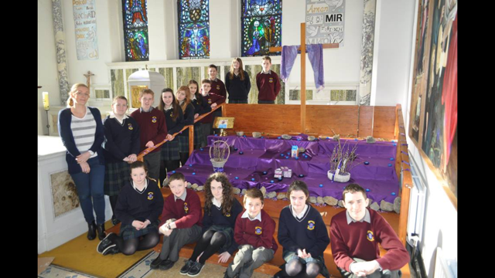
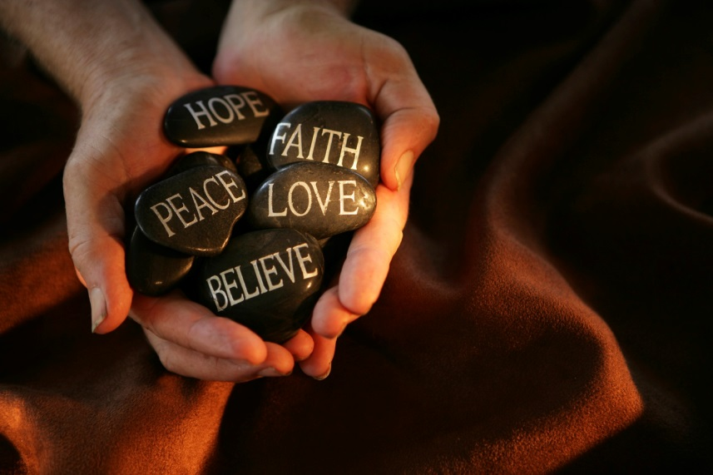
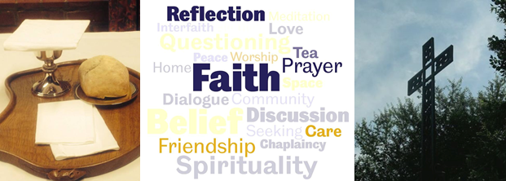
Chaplaincy
What’s Working Well

Slide 2
Policy
Clear
Inclusive
Evaluated & Reviewed by Care Team
Adapted to suit the needs of the school

Slide 3
Academic & Liturgical Calendar
Keeping Important Dates from Both
Opening of the School Year
Retreats
November
Christmas
St. Valentine
Lent
Easter
Liturgies for End of Year

Slide 4
Hard Work But Worth It!
Chaplaincy Team
Thought For The Day
No one is an Island!
We all love stories!

Slide 5
Linking With Others
Pay It Forward
SOAR
9:10 Thought for the Day – read by one of the senior students over the intercom
Morning classes –Smiley Face Balloons and Memes are put up around the school.
Students are asked to take on a Random acts of kindness suggestion from the R.A.K. boxes
11:25 Student Traditional Irish Music Group – playing in the circulation area during the break
Random students and staff receive chocolate bars or Easter eggs – to wish them a “Happy Easter”!
1pm Random students received cups of tea/coffee/soft drinks compliments of St. Louis
Afternoon classes – Chaplaincy team write compliments on post its for every student and staff member in the school.
Last class: One class of students with the two RAK leaders attach the compliments to everyone’s lockers and office doors etc. Announcement is made for everyone to be sure to visit their locker before going home for the Easter break.
Was there anything that surprised you about the workshop?
I saw that people I thought were tough are nice people all the same
It was a very positive atmosphere
How much people change by being honest (different side)
Never to judge
You are not the only one with problems
What did you learn about yourself from being part of this workshop?
That some people have had much harder times than me
That you don’t know everything about people
I won’t be judged for saying how I feel about something
I could stand to be less judgemental
What did you learn about others in your year from being part of this workshop?
They are not afraid to talk about their emotions/ themselves
That they trust people and are comfortable as part of our year group
There are people you would never suspect who have had big struggles in their lives
I learned that a lot of the lads have a much softer sensitive side

Slide 6
The Wider Community
Knock Youth Ministry
JPIIs
Senior
Diocesan Day for 5th years
Cycle
Michaela Foundation
Students
VAKs programme
Reading at Parish Church
Prayer Cards each week
Lenten programme in primary schools
Confirmation and First Holy Communion preparation
Pink Ribbon Cycle
Soccer & Gaelic Football skills

Slide 7
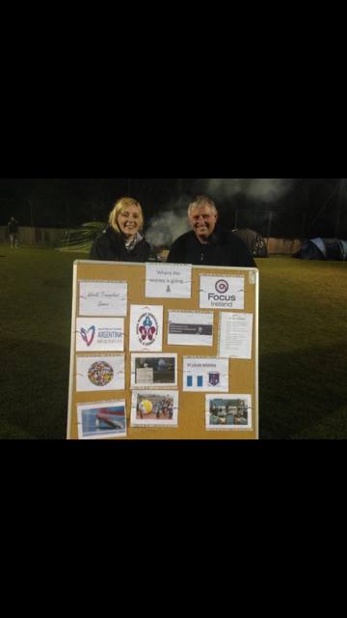
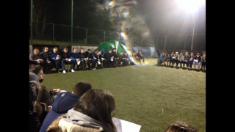
Current Projects
Grotto in the School
Sleep out for Charities

